Slide 1
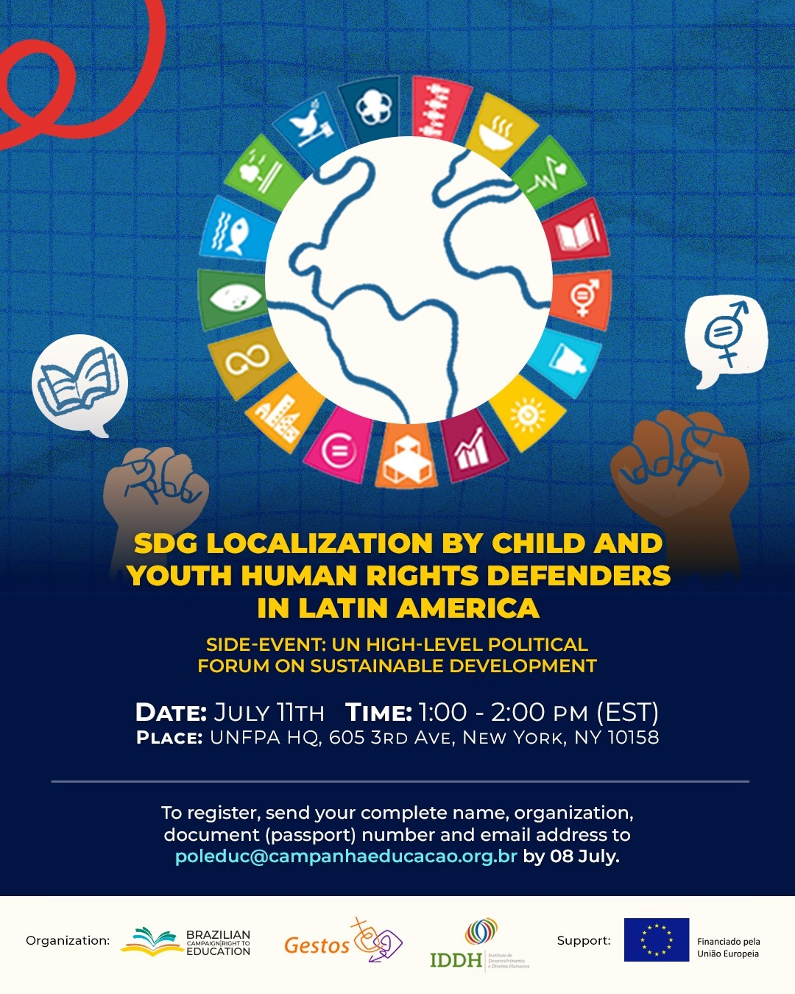
SDG Localization by child and youth human rights defenders in LAC
Andressa Pellanda
General Coordinator
Brazilian Campaign for the Right to Education

Slide 2
Objective
Highlight the role of child and youth human rights defenders as key actors in achieving the 2030 Agenda, emphasizing the importance of multilevel governance arrangements and the involvement of local governments in localizing and achieving the SDGs.

Slide 3
Program
Welcome remarks: Elizeu Chaves Jr., Executive Coordinator of ICPD30 Secretariat and UNFPA Senior Advisor
Introduction to the SDG localization and the Brazilian Spotlight report as a tool for HRD: Alessandra Nilo, Editor of the Spotlight Report and co-founder of Gestos.
Human Rights Education for Child and Youth leadership: Fernanda Lapa, Executive Director – IDDH
Child and Youth HRD advocating for the SDGs from their territories:
Brazil: Andressa Pellanda, General Coordinator, Brazilian Campaign for the Right to Education
Argentina: Marcela Browne, Education Coordinator of the SES Foundation, Secretary of CADE, member of the CLADE Steering Committee and Coordinator of the Participation Mechanism of Civil Society of Latin America and the Caribbean for Sustainable Development
Honduras: Israel Coelho Quirino, CLADE Project Assistant
Children and Youth from 3 countries share their perspectives on audiovisual platforms.
Mediation: Andressa Pellanda

Slide 4
Elizeu Chaves Jr., Executive Coordinator of ICPD30 Secretariat and UNFPA Senior Advisor

Slide 5
Alessandra Nilo, Editor of the Spotlight Report and co-founder of Gestos

Slide 6
Fernanda Lapa, Executive Director of Institute for Development and Human Rights

Slide 7
Institute for Development and Human Rights
Institute for Development and Human Rights (Instituto de Desenvolvimento e Direitos Humanos—IDDH) promotes Human Rights Education (HRE) is a long-term process that promotes tolerance and respect for the dignity of all people and provides means and methods to ensure respect in all societies (A/RES/59/113)

Slide 8
Institute for Development and Human Rights
Interdependence between HRE and the 2030 Agenda and the importance of the role of children and youth human rights defenders:
5th phase of the World Programme for Human Rights Education (2025-2029)
SDG 4.7
Political Declaration of the 2023 SDG Summit

Slide 9
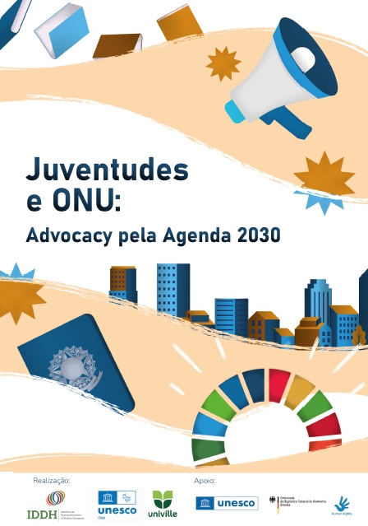
IDDH's Way of Educating
Training: More than 650 youth HRD trained
Articulation and Advocacy: Youth division of the IDDH International Advocacy Network (RAI)

Slide 10
How can we align our practices and discourses too?
Thank you! flapa@iddh.org.br

Slide 11
Andressa Pellanda, General Coordinator of Brazilian Campaign for the Right to Education

Slide 13
“Sometimes, schools are afraid of students, but when you give a voice, give space for choice to these students, they understand democracy, they understand the democratic process, they understand their importance in society through school, with this small gesture. ”
“What we can see is that there is a gain in the representation of this school environment. The group ends up becoming a spokesperson, managing to contribute a lot, including charging the state in relation to issues that are happening within the school. We are happy. An important answer is to be able to understand that this student is different. When you arrive at a school with a student union, you see that there is leadership there and that is important. It is essential for the state to invest in programs like this.”

Slide 14
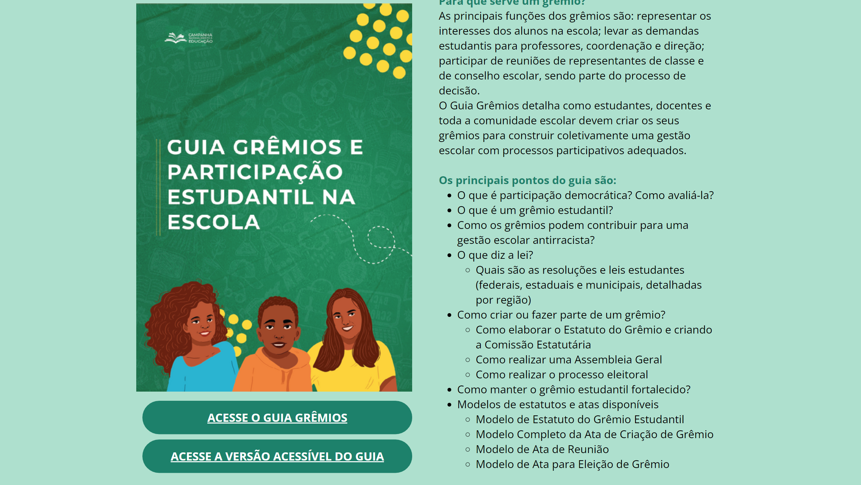

Slide 15
Marcela Browne, Education Coordinator of the SES Foundation, Secretary of CADE, member of the CLADE Steering Committee and Coordinator of the Participation Mechanism of Civil Society of Latin America and the Caribbean for Sustainable Development

Slide 16
Israel Coelho Quirino, Latin American Campaign for the Right to Education Project Assistant

Slide 17
Youth human rights defenders from the regional to the local level
SDG Localization by Child and Youth Human Rights Defenders in Latin America
Campaña Latinoamericana por el Derecho a la Educación – CLADE
HIGH-LEVEL POLITICAL FORUM 2024
Israel Coelho Quirino

Slide 18
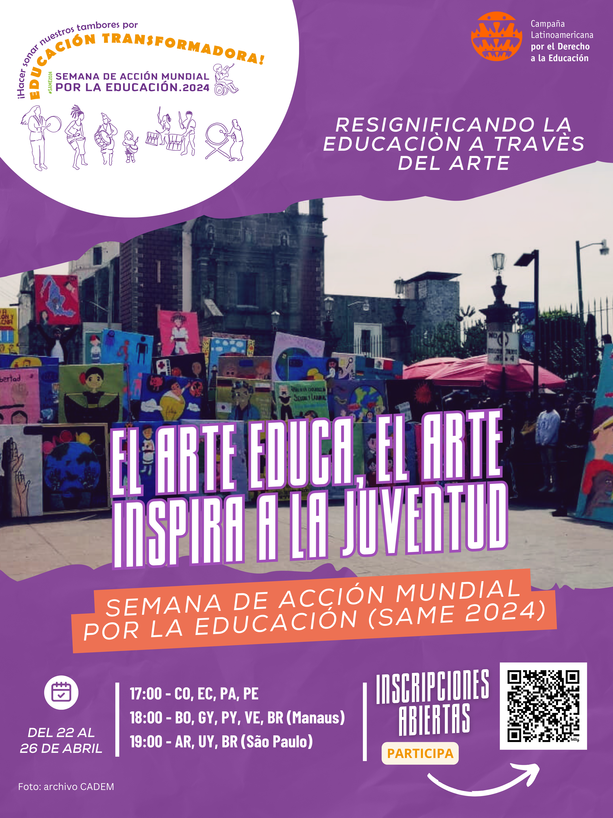
At regional level
Open spaces to talk, express and exchange
On cross-cutting themes
Using attractive, but not limiting strategies

Slide 19
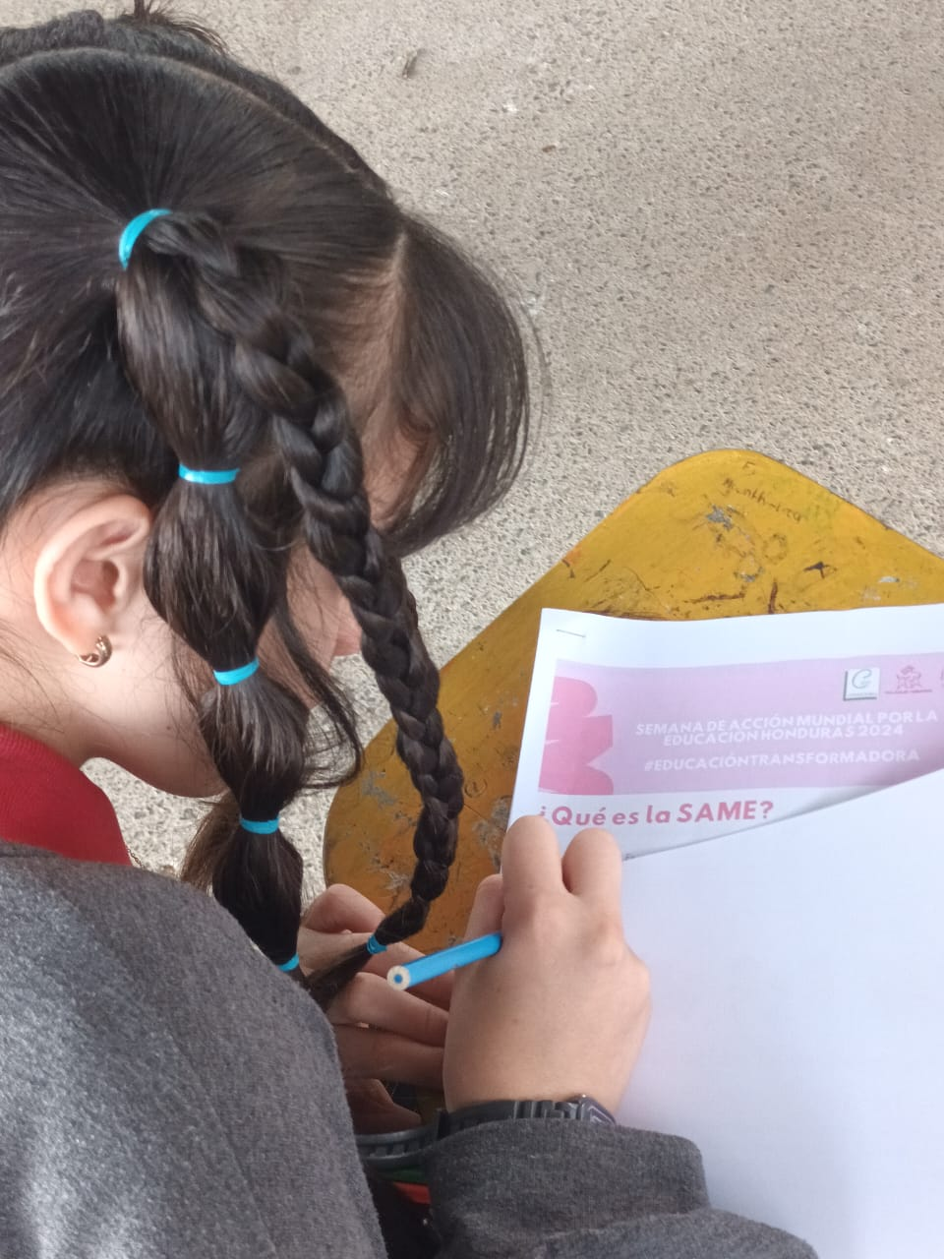
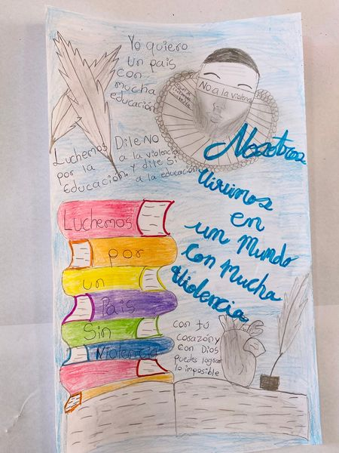
Going local in Honduras

Slide 20
Lessons learned
Intergenerational dialogue
Expression of complex ideas
Concerns on peace, respect, inclusion and diversity
Inputs for change

Slide 21
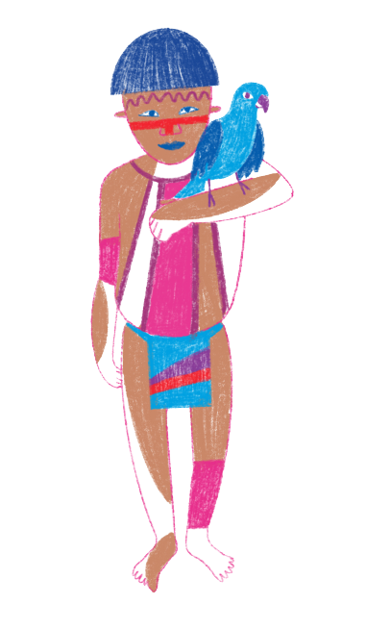
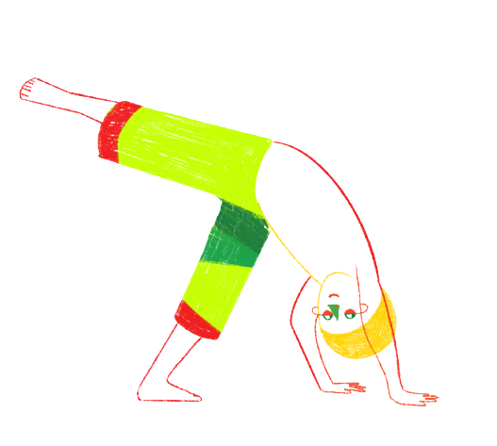
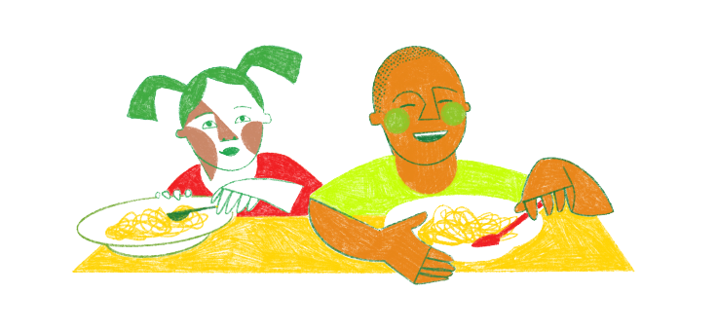
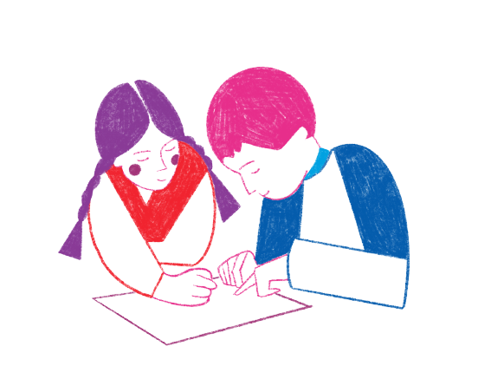

Slide 22
Thank you!

